Slide 1
Student Performance Evaluation
Group 3

Slide 2
Project Overview
Utilize advanced machine learning models and data analysis to predict student performance, focusing
on factors like gender, parental education, test strategies, and academic scores.
Identify patterns and predictors of performance to support equitable educational practices,
aiming to reduce achievement gaps without introducing biases related to gender, race,
or socioeconomic background.
Provide clear visualizations and insights that are accessible to educators, parents, and
policymakers, enabling informed decision-making and targeted interventions, such as personalized
tutoring for at-risk students.

Slide 3
2. Data Description
This dataset contains information about students' demographic details, study habits, parental involvement, and academic performance.
Student ID: Unique identifier (1001 to 3392).Demographic Details:
Age: Ranges from 15 to 18 years.
Gender: - 0: Male , 1: Female
Ethnicity: - 0: Caucasian, 1: African American, 2: Asian, 3: Other
Parental Education: - 0: None, 1: High School, 2: Some College, 3: Bachelor's, 4:Higher
StudyTimeWeekly: 0 to 20 hours.
Absences: 0 to 30 days.
Tutoring: - 0: No, 1: Yes
Parental Support: - 0: None, 1: Low, 2: Moderate, 3: High, 4: Very High
Extracurricular: - 0: No, 1: Yes
Sports, Music, Volunteering: Similar binary coding.
GPA: Scale from 0 to 4.0.
Target Variable:
GradeClass: Based on GPA: - 0: 'A' (GPA >= 3.5), 1: 'B' (3.0 <= GPA < 3.5), 2: 'C' (2.5 <= GPA < 3.0), 3: 'D' (2.0 <= GPA < 2.5), 4: 'F' (GPA < 2.0)

Slide 4
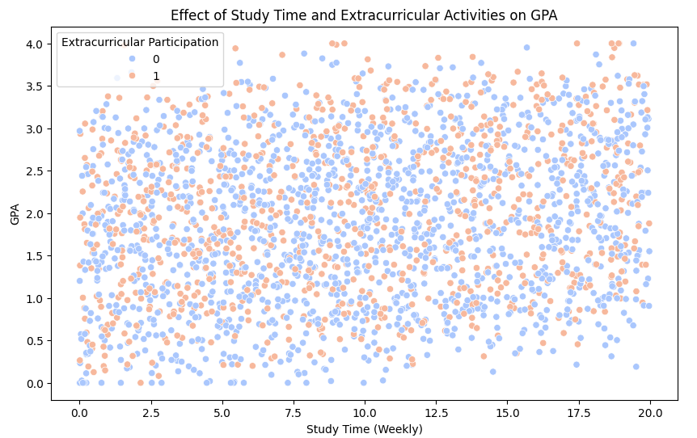
Exploratory Data Analysis
Positive Correlation Between Study Time and GPA:
There is a general upward trend, indicating that students who spend more time studying tend to achieve higher GPAs.
Effect of Extracurricular Participation:
The colors do not show a significant difference in the spread of GPA values.
This suggests that while study time positively impacts GPA, extracurricular participation alone does not seem to have a strong influence on academic performance.
The analysis suggests that study time has a more direct and positive impact on GPA than extracurricular participation. However, involvement in extracurricular activities does not appear to negatively affect academic performance, indicating that students can engage in such activities while maintaining good grades.

Slide 5
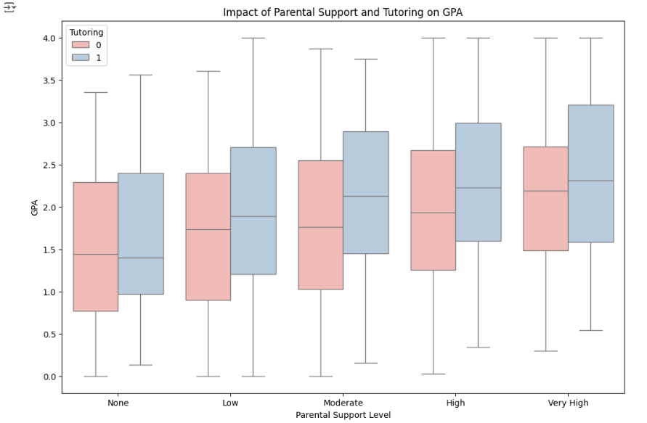
Influence of Parental Support:
As the level of Parental Support increases (from "None" to "Very High"), the median GPA also tends to increase.
Effect of Tutoring:
Students who received tutoring generally show higher GPAs compared to those who did not, especially at lower levels of parental support.
At higher levels of parental support (e.g., "High" and "Very High"), the difference in GPA between tutored and non-tutored students diminishes. This may indicate that strong parental support compensates for the need for additional tutoring.
Combination of Support and Tutoring:
The highest GPAs are observed for students who have both high parental support and tutoring, highlighting the combined benefit of family involvement and extra academic assistance.

Slide 6
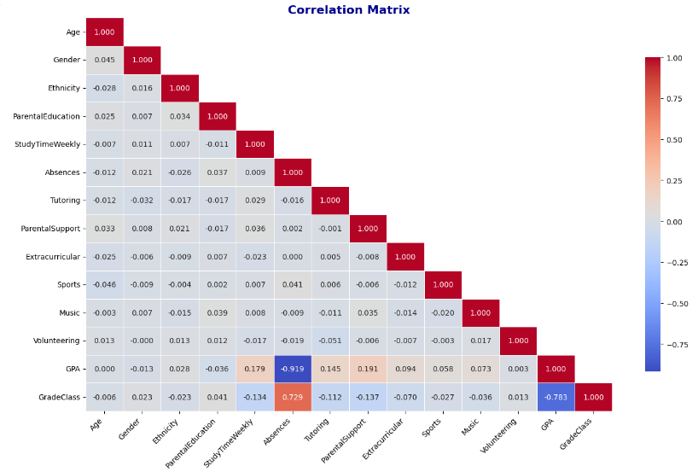
Analysis of the Correlation Matrix
The correlation matrix heatmap shows the relationships between numeric variables in the dataset
Absences and GPA: Strong negative correlation (-0.919), indicating higher absences are linked to lower GPA.
GPA and GradeClass: High negative correlation (-0.783) with GradeClass, showing GPA is a strong predictor of student grades.
Parental Support and GPA: Moderate positive correlation (0.191), suggesting higher parental support is associated with better academic performance.
Conclusion:
The correlation matrix reveals meaningful relationships between several factors and student GPA. It highlights the importance of study time, attendance, and parental support in influencing academic performance, while extracurricular activities show minimal direct impact.

Slide 7
Model Selection
Support Vector Classifier:
Reason: Given the complex interplay of features like Absences, StudyTimeWeekly, and parental involvement, SVC is well-suited to identify subtle patterns and classify students into different performance categories.
Decision Tree
Reason: Decision Trees can provide insights into the most important factors influencing student performance
Random Forest Classifier
Reason: The diverse nature of the dataset, including both numerical (e.g., age, study time) and categorical (e.g., gender, ethnicity, parental education) features, makes Random Forest a suitable choice. It can handle both types of data effectively and may reduce overfitting.

Slide 8
Model Selection
4. Catboost
Reason: The dataset contains numerous categorical features (e.g., ethnicity, parental education, tutoring, parental support), which CatBoost can handle efficiently. It can automatically handle categorical features without requiring extensive feature engineering, making it a time-efficient and effective choice.
5. Gradient Boosting Classifier
Reason: Gradient Boosting is well-suited for tasks with complex relationships between features and the target variable. In this case, factors like volunteering, parental involvement, and extracurricular activities can interact in intricate ways to influence student performance. Gradient Boosting can capture these complex interactions and make accurate predictions.

Slide 9
Model Comparison
Model | Best Parameters | Accuracy | Precision | Recall | F1-Score | Performance
Support Vector Classifier | C=10, gamma=scale, kernel=linear | 83.00% | 0.84 | 0.83 | 0.81 | Moderate accuracy; struggles with precision in classifying grade 0
Random Forest | max_depth=20, min_samples_split=2, n_estimators=200 | 91.00% | 0.91 | 0.91 | 0.91 | High recall and balanced performance across all classes
Decision Tree | min_samples_split=8, min_samples_leaf=1, max_depth=5 | 91.23% | 0.91 | 0.91 | 0.91 | High accuracy and balanced precision, recall, and F1

Slide 10
Model | Best Parameters | Accuracy | Precision | Recall | F1-Score | Performance
CatBoost | depth=3, iterations=500, l2_leaf_reg=1, learning_rate=0.01 | 92.07% | 0.92 | 0.92 | 0.92 | Strong in handling categorical data; high F1 score
Gradient Boosting | learning_rate=0.1, max_depth=5, n_estimators=50 | 92.48% | 0.93 | 0.92 | 0.93 | Best overall F1 score and high precision across all classes
Overall, Gradient Boosting achieved the best performance, with the highest F1 score and balanced accuracy, precision, and recall across all grade classes.

Slide 11
Model Training - Gradient Boosting Classifier
Model Overview:
Algorithm: Gradient Boosting Classifier – a powerful ensemble method combining multiple decision trees.
Initial Setup: Model initialized with random_state=42 for reproducibility.
Training & Evaluation:
Initial Training: Model trained using default hyperparameters.
Metrics Evaluated: Accuracy, Precision, Recall, F1 Score.
Classification Report: Strong overall performance, with high precision and recall for most classes.
Hyperparameter Tuning:
Grid Search: Identified best parameters (n_estimators, learning_rate, max_depth).
Random Search: Further refined model with randomized hyperparameter search.
Manual Tuning: Adjusted learning_rate=0.05, n_estimators=150, and max_depth=5 for better generalization.
Performance After Tuning:
Manually Tuned Model: Achieved balanced performance across metrics with improved recall and precision.
Visualizations:
Confusion Matrix: Visualized model's classification errors.
Precision-Recall Curve: Evaluated trade-off between precision and recall.
Accuracy vs. Number of Estimators: Plotted to observe model behavior across iterations.
Notes:
1."We used Gradient Boosting, which is a popular machine learning algorithm that combines multiple decision trees in a sequential way. The goal of this method is to create a model that is more accurate by correcting the mistakes of earlier trees. It’s known for handling both classification and regression tasks well, and it's very effective in real-world data with complex patterns."
2. We started by training the model with its default settings, then evaluated its performance using several metrics, such as accuracy, precision, recall, and F1 score. These metrics help us assess how well the model is doing. The classification report showed that our model had strong overall performance, especially in terms of precision and recall, meaning it was good at identifying both positive and negative cases in most classes."
3. To improve the model’s performance, we performed hyperparameter tuning. First, we used Grid Search, which methodically tries different combinations of parameters like the number of estimators, learning rate, and depth of the trees. Then, we refined the model further with Random Search, which randomly tests parameter values over a wider range. Finally, based on the results, we manually tuned the model’s parameters: we reduced the learning rate to 0.05, increased the number of trees to 150, and set the tree depth to 5 for better generalization."
4.After tuning the hyperparameters, the manually tuned model showed significant improvement. It achieved a good balance between precision and recall, meaning it was more reliable in identifying positive and negative cases without overfitting or underfitting."
5.To better understand the model’s performance, we used several visualizations:
Confusion Matrix: This shows where the model made errors, which helps us understand its strengths and weaknesses.
Precision-Recall Curve: This graph shows the trade-off between precision and recall, helping us evaluate how well the model can handle false positives and false negatives.
Accuracy vs. Number of Estimators: We plotted accuracy as a function of the number of trees (n_estimators) to observe how performance improves as the model learns from more trees."

Slide 12
Model Performance
Best Model: Gradient Boosting
Accuracy: 92%
F1 Score: 0.92 (strong balance of precision & recall)
Macro Avg. F1: 0.86 | Weighted Avg. F1: 0.92
Key Strengths: Consistent performance across classes, especially high-support classes; robust handling of imbalanced data.
Other Models:
Decision Tree: Accuracy: 91%, but more variability in recall for low-support classes.
Random Forest & CatBoost: Accuracy around 91-92%, but Gradient Boosting showed better overall stability and class balance.
SVC: Struggled with low-recall for class 0, particularly for imbalanced data.
Key Insight:
Gradient Boosting provided the most balanced and reliable performance across all classes, outperforming other models in overall metrics.
Notes:
"After evaluating all the models, the Gradient Boosting Classifier stood out as the best performing model:
Accuracy: The Gradient Boosting model achieved 92% accuracy, which means it correctly predicted 92% of the student grades in our test data.
F1 Score: The F1 Score is another key metric, and it was 0.92 for Gradient Boosting. This is great because the F1 score balances both precision (how many of the predicted positives are actually correct) and recall (how many of the actual positives were identified correctly). A high F1 score means the model is reliable and not favoring one over the other.
Macro Avg. F1 (0.86): The Macro Average F1 score tells us how the model performed on average across all classes. An F1 of 0.86 is strong and shows that the model did well across all classes, even those with fewer examples.
Weighted Avg. F1 (0.92): The Weighted Average F1 gives more importance to the larger classes, and the fact that it’s also 0.92 means the model has performed consistently across all types of grades, including those with more students.
Key Strengths: Gradient Boosting showed a strong balance between precision and recall, making it a reliable model for predicting student grades. It also handled imbalanced data very well, meaning it didn’t favor the larger classes but instead gave good results across the board."
Other Models:
"Let’s quickly review how the other models performed:
Decision Tree: It had a 91% accuracy, which is close to Gradient Boosting, but it had more variability in recall, especially for low-support classes (i.e., grades with fewer students). This means that while it was accurate, it didn’t always do a good job at identifying all cases, especially in smaller classes.
Random Forest & CatBoost: Both of these models also performed well, with accuracy around 91-92%, similar to Gradient Boosting. However, Gradient Boosting consistently showed better stability and a better balance across different classes. It wasn't just focused on the large, easy-to-predict classes, but also performed well on the more challenging, imbalanced classes.
SVC (Support Vector Classifier): This model struggled with low-recall for class 0. In simpler terms, it had trouble correctly identifying all the students in this particular grade class. This is particularly a concern for imbalanced datasets, where some classes are underrepresented, and SVC had trouble handling this imbalance. Gradient boosting provided the most balanced and reliable performance across all classes,outperforming other models in overall metrics.

Slide 13
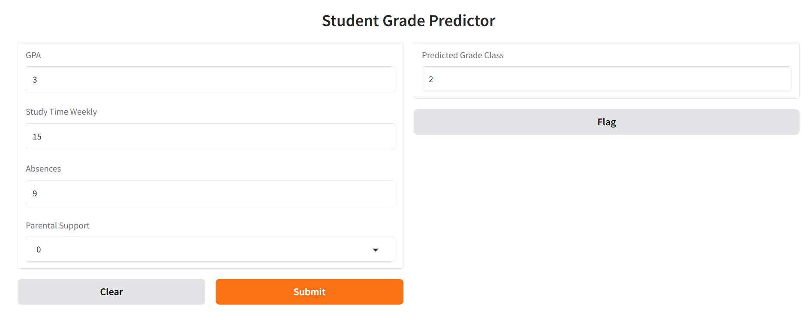
Deployment
8. Solution Validation

Slide 14
Future Work
Improvements on Low-Support Classes: Models struggled to predict correctly for class 0, likely due to low sample size. To enhance performance we should work on gathering more balanced data.
Parameter Tuning: The current parameter tuning could be further optimized, especially for models like SVC, which underperformed on certain metrics.
Feature Engineering: Exploring new features or engineering additional variables from existing ones (e.g., considering interaction terms) could refine model accuracy.
Model Ensemble: Combining the best-performing models (e.g., Gradient Boosting and CatBoost) in an ensemble may improve prediction stability across all classes.

Slide 15
Thank You

